Slide 1

Bridging Panama’s Climate Data Gap Through Academic Institutions
Tomás Schmieder, B.S. Environmental Engineering, May 2026
CRP 3545 – Proposal Presentation
November 17th, 2025

Slide 2
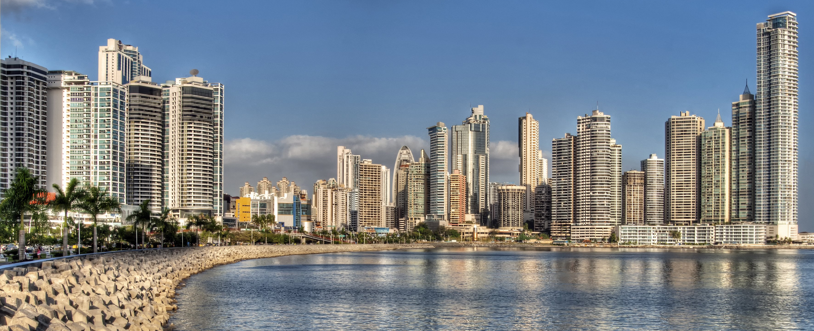
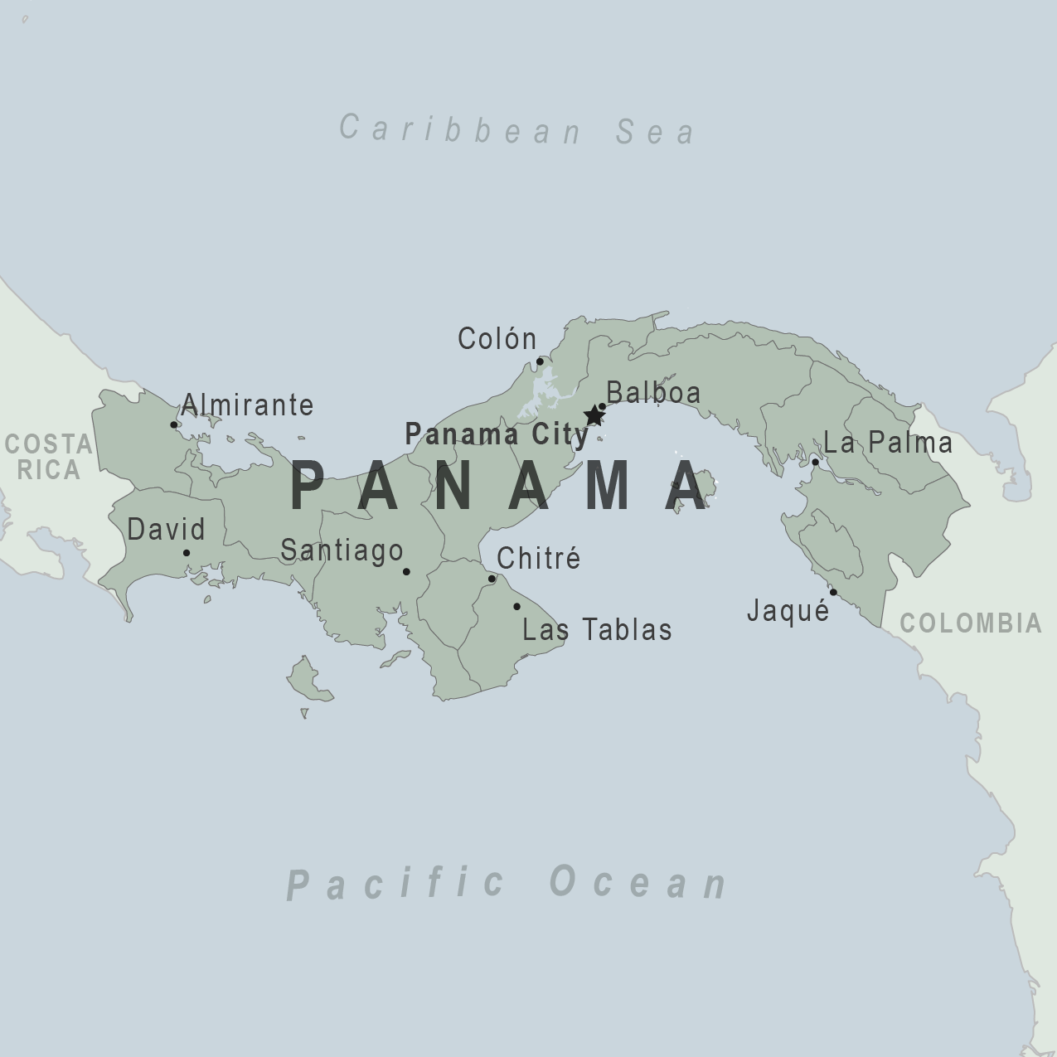
Background
Panama City has positioned itself as a regional hub for the world’s economy. Its foundation is fragile. As a tropical, low-lying coastal city, it is highly vulnerable to floods, landslides, and extreme weather events. As it’s positioned itself as a developing country, it is constrained by climate adaptation efforts, due to two key failures, institutional fragmentation and critical data deficits.

Slide 3

The climate data gap
A 2022 evaluation of Panama’s MiAmbiente (Ministry of Environment) official Monitoring and Evaluation (M&E) system for climate adaptation was conducted by the Initiative for Climate Action Transparency (ICAT), finding that the current framework is non-functional.
The framework consists of 21 climate indicators, but within the data of these indicators, the data was analyzed to be,
Fragmented: Data is siloed across 17 uncoordinated institutions,
Confusing: 52% of the indicators have critical “data specificity” issues, providers are unclear on what to measure,
Exclusive: None of the data for the indicators are generated by local communities, relying solely on top-down sources.
Notes:
In Panamá’s Monitoring & Evaluation framework created in partnership with the Initiative for Climate Action Transparency (ICAT), a total of 21 climate indicators were identified.
Ex: Working organizations that include climate change adaptation, Number of Tide gauges installed, percentage of people displaced from their homes as a result of floods, municipalities with local regulations that consider climate change adaptation and vulnerability assessments, …
However, these climate indicators were inconsistent, not sharing common measurements, and coming from 17 different institutions. Common confusion was found about the quantification and measurement of the indicators.
52% of the indicators were identified in having data specific issues
And notably the indicators and data do not take into account or are generated from local-communities. All relying on top-down institutions as sources.

Slide 4


Why the data gap is a problem
Without functional indicators, adaptation planning is unable to move forward, withholding progress in areas such as,
Climate Data
Resource Allocation
Financial Assistance
Proactive Planning
Notes:
Resource Allocation: Inability to target investments into neighborhoods that need the most, because we lack the ability to identify them
Financial Access: We are unable to unlock international climate financing without the ability to quantitatively prove that our adaptation strategies are working
Proactive Planning: We will remain in a cycle of reactive disaster response, rather than proactive adaptation because we lack the predictive data to act early

Slide 5

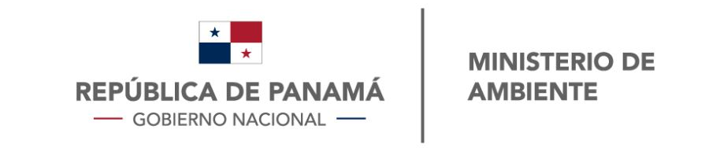
Closing the gap
It’s clear that we need a way to create a reliable pipeline for functional, community-verified climate indicators.
To do this a formal partnership is proposed between, the Ministry of the Environment and Panama’s Universities to establish a University Climate Observatory, a program where students are trained to conduct the exact vulnerability assessments and community monitoring needed to close the data gap.
Notes:
It’s clear that functional and consistent climate indicators are needed so that climate resilience and adaptation planning can move forward supported by a data-driven framework.
To gain these indicators, it is proposed to create a partnership between Panamá’s universities and MiAmbiente, the owner of the M&E framework and the ones most impacted by the data gap, to create a program that will work with students to conduct vulnerability assessments and monitoring of local communities.

Slide 6
Implementation: The University Climate Observatory Framework
To implement this framework, we propose to align a current universities mandate with a critical national need,
  The Latin University of Panama, has an existing constitution, article 301, acting as a regulation and requirement for students to perform 100 hours of community service or Trabajo Comunal Universtiario (TCU).
  This mandate could be piloted, and scaled, to extend to all universities in Panamá, repurposing this mandate toward beneficial data collection and assessment of climate vulnerable communities.
University Climate Observatory
Community Vulnerability Assessments
Climate Data
Data-Driven National Policy
Notes:
To implement this framework, we propose to align two existing systems, 1. MiAmbiente’s critical data and workforce gap, and 2. A Mandate, The Latin University of Panama, has an existing constitution, article 301, acting as a regulation, and requirement for students to perform 100 hours of community service. The community service can be acted in the form of
-
This purpose could be piloted, and scaled, to extend to all universities in Panama, repurposing this mandate toward beneficial data collection and assessment of climate vulnerable communities.

Slide 7
A transformative model
Pilot Funding & Training
University Climate Observatory
Community Vulnerability Assessments
Climate Data
Data-Driven National Policy
TCU Mandate
Resource Allocation
Financial
Assistance
Proactive Planning
Notes:
Therefore to address the climate adaptation gap, it would be beneficial, for Panama’s Ministry of the Environment, to partner with Local Universities so that they can clear the data deficit, while also benefitting students
This program would allow not only for data to be collected through university students but also train them in climate vulnerability assessments. Readying them for future work.
It shifts a “top-down” planning approach into becoming a participatory governance framework.
Communities are no longer victims of change to be studied, they instead become active partners in generating the knowledge needed to protect their neighborhoods.
This framework is also scalable, as previously mentioned, a pilot project could start with the Universidad Latina in Panama City, and then expand nationally, to mobile students across the country to help monitor climate hazards and generate indicators for other parts of Panama.
.

Slide 8
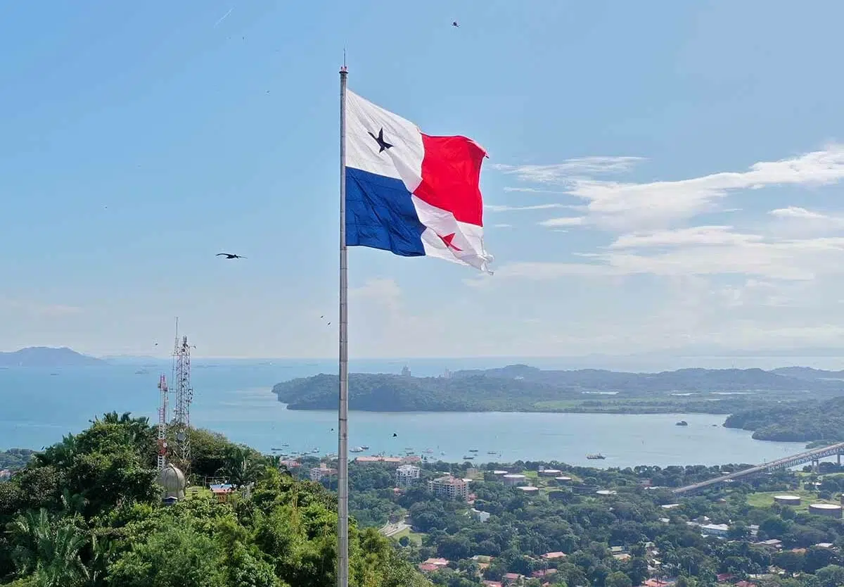
Thank you.
Questions?

